Slide 1



Python 3 Beginner
Chapter 00
Previously, on Python 3 Beginner…
release 1.0.0
37/39 Avenue Ledru Rollin – CS 11237 – 75750 PARIS CEDEX 12 - info@valnaos.com – www.valnaos.com Tél : 01 86 95 20 48

Slide 2

What we saw last time
Python 3 Beginner
Learning

Slide 3

Cloud Technology Associate
Copyright © 2018 | 9
Q&A
37/39 Avenue Ledru Rollin – CS 11237 – 75750 PARIS CEDEX 12 - info@valnaos.com – www.valnaos.com Tél : 01 86 95 20 48

Slide 4

Where? Who?
Python 3 Beginner
Class Material
GitHub: https://github.com/cstar-industries/python-3-beginner
Instructor
Charles Francoise <charles@cstar.io>

Slide 5

Session Objectives
Python 3 Beginner
At the end of this session, you will be able to:
Define

Slide 6
Session Syllabus
Python 3 Beginner
Chapter | Subject | Start | End | Total Time (in hours)
00 | Previously on Python 3 Beginner… | 14:00 | 14:15 | 00:15
01 | Functions: Part I | 14:15 | 15:00 | 00:45
 | Coffee Break | 15:00 | 15:10 | 00:10
02 | Functions: Part II | 15:10 | 15:55 | 00:45
 | Coffee Break | 15:55 | 16:05 | 00:10
03 | Generators and Error Handling | 16:05 | 16:50 | 00:45
 | Coffee Break | 16:50 | 17:00 | 00:10
 | Workshop | 17:00 | 18:00 | 01:00
 | Total |  |  | 04:00

Slide 7
Python 3 Beginner
Chapter 01
HTTP with Requests
release 1.0.0
37/39 Avenue Ledru Rollin – CS 11237 – 75750 PARIS CEDEX 12 - info@valnaos.com – www.valnaos.com Tél : 01 86 95 20 48

Slide 8
Requests
Python 3 Beginner
Requests is a library that makes HTTP requests very simple, while still providing powerful in-depth options
"HTTP for Humans"
Perfect for downloading/uploading data, or communicating with a web service API

Slide 9
Requests
Python 3 Beginner
HTTP in a nutshell
GET / HTTP/1.1
Accept: */*
Accept-Encoding: gzip, deflate
Connection: keep-alive
Host: www.google.com
User-Agent: HTTPie/1.0.2
HTTP/1.1 200 OK
Cache-Control: private, max-age=0
Content-Encoding: gzip
Content-Type: text/html; charset=ISO-8859-1
Date: Tue, 12 May 2020 08:34:48 GMT
Expires: -1
Server: gws
Set-Cookie: 1P_JAR=2020-05-12-08; expires=Thu, 11-Jun-2020 08:34:48 GMT; path=/; domain=.google.com; Secure
Transfer-Encoding: chunked
<!doctype html><html itemscope="" itemtype="http://schema.org/WebPage" lang="fr"><head> <meta content="text/html; charset=UTF-8" http-equiv="Content-Type"><meta content="/images/branding/googleg/1x/googleg_standard_color_128dp.png" itemprop="image"><title>Google</title>...

Slide 10
Requests
Python 3 Beginner
requests.get sends a GET request
Returns a Response object with info about the data
res = requests.get('https://google.com')
print(res.ok)
print(res.status_code)
print(res.reason)
print(res.elapsed)
True
200
OK
0:00:00.085902

Slide 11
Requests
Python 3 Beginner
The response content is available in several forms
type(res.text)
type(res.content)
str
bytes
Parse a JSON response directly to a dict
type(res.json())
dict

Slide 12
Requests
Python 3 Beginner
Read the response headers in dict form
print(res.headers)
{'Date': 'Tue, 12 May 2020 10:00:57 GMT',
'Expires': '-1',
'Cache-Control': 'private, max-age=0',
'Content-Type': 'text/html; charset=ISO-8859-1
...
Parse a JSON response directly to a dict
type(res.json())
dict

Slide 13
Requests
Python 3 Beginner
Raise a Python error on HTTP errors
res = requests.get('https://google.com/toto')
print(res.ok)
print(f'{res.status_code} {res.reason}')
res.raise_for_status()
False
404 Not Found
HTTPError: 404 Client Error: Not Found for url: https://google.com/toto
Other HTTP methods are available
res = requests.post('https://httpbin.org/post', data=...
res = requests.put('https://httpbin.org/post', data=...
res = requests.delete(...
res = requests.head(...
res = requests.request('GET', 'https://...

Slide 14
Requests
Python 3 Beginner
Send query variables with params
res = requests.get('https://www.google.com/search',
params={'q':'Hello World'})
print(res.url)
https://www.google.com/search?q=Hello+World
Send data in request body with data
res = requests.post('https://httpbin.org/post',
data=b'Hello World!')
res = requests.post('https://httpbin.org/post',
data={'hello': 'world', 'search': 'python'})
print(res.request.body)
hello=world&search=python

Slide 15
Requests
Python 3 Beginner
Encode request data as JSON
res = requests.post('https://httpbin.org/post',
json={'hello': 'world', 'python': None})
print(res.request.body)
b'{"hello": "world", "python": null}'
Send file attachments
with open('profile_pic.png', 'rb') as f:
res = requests.post('https://httpbin.org/post',
files={'upload': f})
len(res.request.body)
669525

Slide 16
Requests
Python 3 Beginner
Customize request headers
res = requests.get('https://httpbin.org/post',
headers={'Authorization': 'alibaba:opensesame'})
print(res.request.body)
b'{"hello": "world", "python": null}'
Set request timeout
res = requests.get('https://www.google.com', timeout=0.001)
ConnectTimeout: 'Connection to www.google.com timed out. (connect timeout=0.001)'))

Slide 17
Python 3 Beginner
Chapter 02
Web Applications with Flask
release 1.0.0
37/39 Avenue Ledru Rollin – CS 11237 – 75750 PARIS CEDEX 12 - info@valnaos.com – www.valnaos.com Tél : 01 86 95 20 48

Slide 18
Flask
Python 3 Beginner
Flask is a micro-framework for building web applications
Use Flask to build web servers simply and efficiently without worrying about low-level details
Flask is perfect to build web applications with a JSON-based REST API
Use Flask wherever you would use PHP, Node.js or other non-Python backend technology

Slide 19
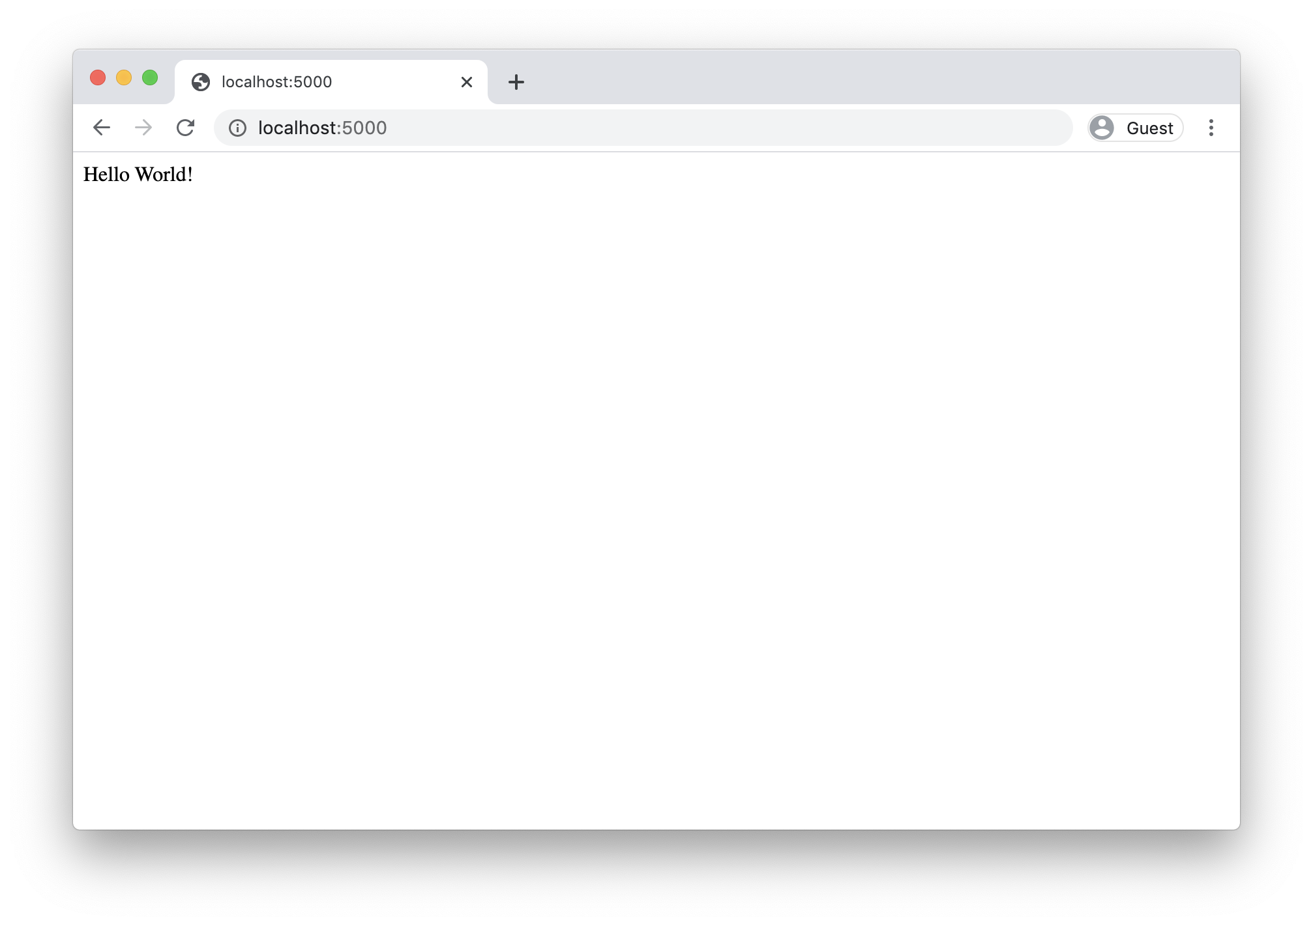
Flask
Python 3 Beginner
127.0.0.1 - - [12/May/2020 17:35:32] "GET / HTTP/1.1" 200 -
127.0.0.1 - - [12/May/2020 17:35:32] "GET /favicon.ico HTTP/1.1" 404 -

Slide 20
Requests
Python 3 Beginner
Run Flask in debug mode:
Extra info in response on errors
Automatic reload whan a file changes
FLASK_ENV=development FLASK_APP=main.py flask run
By default, only GET is supported by your route definitions
Use methods argument in the decorator
@app.route('/', methods=['GET', 'POST'])
def index():
return 'Hello World!'

Slide 21
Requests
Python 3 Beginner
Run Flask in debug mode:
Extra info in response on errors
Automatic reload whan a file changes
FLASK_ENV=development FLASK_APP=main.py flask run
By default, only GET is supported by your route definitions
Use methods argument in the decorator
@app.route('/', methods=['GET', 'POST'])
def index():
return 'Hello World!'

Slide 22
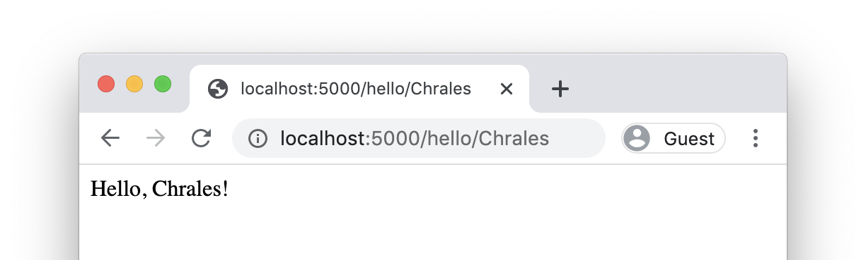
Requests: Defining routes
Python 3 Beginner
Define more routes with the route decorator
@app.route('/hello')
def hello():
return '<html><body>Hello</body></html>'
Capture variables from the address
@app.route('/hello/<name>')
def hello(name):
return f'<html><body>Hello, {name}!</body></html>'

Slide 23
Python 3 Beginner
Chapter 03
Generators and Error handling
release 1.0.0
37/39 Avenue Ledru Rollin – CS 11237 – 75750 PARIS CEDEX 12 - info@valnaos.com – www.valnaos.com Tél : 01 86 95 20 48

Slide 24
Generator functions
Python 3 Beginner
You can build your own functions to use in a for iteration
def fib_range(n):
if n > 0:
yield 0
if n > 1:
yield 1
f0 = 0
f1 = 1
for _ in range(n - 2):
f = f0 + f1
yield f
f0 = f1
f1 = f

Slide 25
Generator functions
Python 3 Beginner
Each time the iteration loops, the function runs until the next yield statement
for f in fib_range(8):
print(f)
0
1
1
2
3
5
8
13

Slide 26
Iterators
Python 3 Beginner
You can also progress on an iterator using the built-in next() function
z = zip(firstname, lastnames, dobs)
first, last, dob = next(z)
while first != 'Guido' and last != 'van Rossum':
first, last, dob = next(z)
print(f'{first} {last} was born on {dob}')
print('We found Guido!')
Dennis Ritchie was born on September 9, 1941
Ken Thompson was born on February 4, 1943
Niklaus Wirth was born on February 15, 1934
We found Guido!

Slide 27
Errors
Python 3 Beginner
You've already seen some errors
print(l)
NameError: name 'l' is not defined
l = (0, 1, 2)
l.pop()
AttributeError: 'tuple' object has no attribute 'pop'
l[0] = 'zero'
TypeError: 'tuple' object does not support item assignment

Slide 28
Errors
Python 3 Beginner
Errors "bubble up" function calls
def print_sqrt(n):
print(f'The square root of {n} is {math.sqrt(n)}')
def print_rnd_sqrt():
print_sqrt(random() – 0.5)
print_rnd_sqrt()
Traceback (most recent call last):
File "<stdin>", line 1, in <module>
File "<stdin>", line 2, in print_rnd_sqrt
File "<stdin>", line 2, in print_sqrt
ValueError: math domain error

Slide 29
Catching Errors
Python 3 Beginner
Errors "bubble up" function calls
def print_sqrt(n):
try:
print(f'The square root of {n} is {math.sqrt(n)}')
except:
print(f'Could not compute the square root of {n}')
print_rnd_sqrt()
Could not compute the square root of -0.3587785826661578
Open a try block to capture errors in unsafe code
Handle errors in an except block

Slide 30
Ignoring Errors
Python 3 Beginner
Use the pass statement to ignore errors in except handlers
def list_sqrt(in_list):
out_list = []
for n in in_list:
try:
out_list.append(math.sqrt(n))
except:
pass
return out_list
list_sqrt([2, -1, 16, 'zero', None, 256])
[1.4142135623730951, 4.0, 16.0]
The pass statement can be used anywhere, when a block should do nothing

Slide 31
Errors should not be (silently) ignored!
Python 3 Beginner
Use the pass statement to ignore errors in except handlers
def list_sqrt(in_list):
out_list = []
for n in in_list:
try:
out_list.append(math.sqrt(n))
except:
pass
return out_list
list_sqrt([2, -1, 16, 'zero', None, 256])
Never do this, actually! 🚨
[1.4142135623730951, 4.0, 16.0]
The pass statement can be used anywhere, when a block should do nothing

Slide 32
Catching specific errors
Python 3 Beginner
Specify the type of error you wish to catch after except
x = None
while x is None:
try:
x = int(input('Enter an integer number: '))
except ValueError:
print(f'Could not parse integer.')
Enter an integer number: fe
Could not parse integer.
Enter an integer number: ^C
Traceback (most recent call last):
File "<stdin>", line 3, in <module>
KeyboardInterrupt

Slide 33
Catching specific errors
Python 3 Beginner
Specify the type of error you wish to catch after except
x = None
while x is None:
try:
x = int(input('Enter an integer number: '))
except ValueError:
print(f'Could not parse integer.')
Enter an integer number: fe
Could not parse integer.
Enter an integer number: ^C
Traceback (most recent call last):
File "<stdin>", line 3, in <module>
KeyboardInterrupt

Slide 34
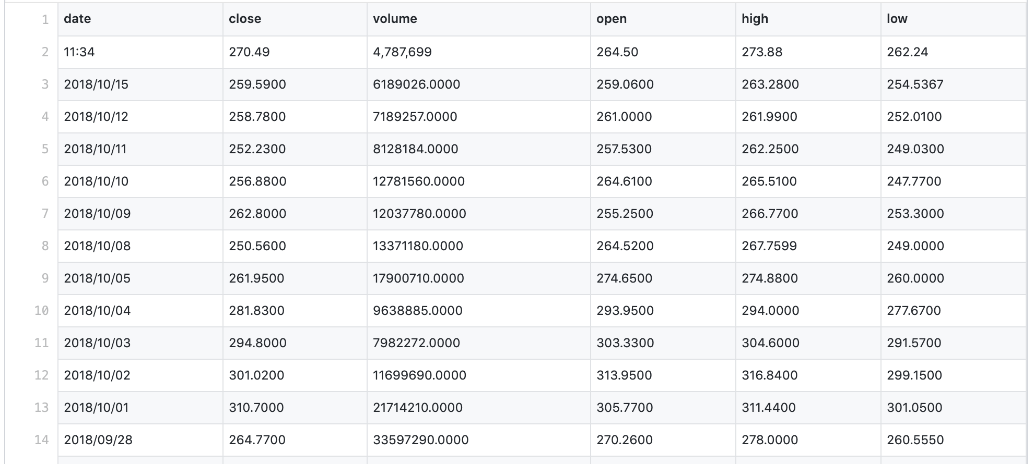
Deeper into error handling
Python 3 Beginner
For the following slides we will be trying to read a csv containing stock prices with the following format

Slide 35
Deeper into error handling
Python 3 Beginner
This is the program we wrote
def read_csv(path):
rows = []
f = open(path)
s = f.read().splitlines()
for row in s:
row = row.split(',')
date = datetime.strptime(row[0], '%Y/%m/%d')
price = float(row[1])
rows.append((date, price))
f.close()
return rows
This program has many possible errors. Let's dig deeper into it!

Slide 36
Deeper into error handling
Python 3 Beginner
def read_csv(path):
rows = []
f = open(path)
s = f.read().splitlines()
for row in s:
row = row.split(',')
date = datetime.strptime(row[0], '%Y/%m/%d')
price = float(row[1])
rows.append((date, price))
f.close()
return rows
Possible errors with the file:
File may not exist
User may not have read rights to the file
Hard drive may be unable to read
...

Slide 37
Deeper into error handling
Python 3 Beginner
def read_csv(path):
rows = []
f = open(path)
s = f.read().splitlines()
for row in s:
row = row.split(',')
date = datetime.strptime(row[0], '%Y/%m/%d')
price = float(row[1])
rows.append((date, price))
f.close()
return rows
Possible errors reading lines:
row may not have data at indexes 0 or 1
date may not be correctly formatted
price column may not contain a value convertible to float

Slide 38
Deeper into error handling
Python 3 Beginner
Let's handle those errors
def read_csv(path):
rows = []
try:
f = open(path)
s = f.read().splitlines()
for row in s:
row = row.split(',')
date = datetime.strptime(row[0], '%Y/%m/%d')
price = float(row[1])
rows.append((date, price))
f.close()
except OSError as err:
print(f'Failed to open file. {err}')
except ValueError as err:
print(f'Invalid data. {err}')
except:
raise
return rows

Slide 39
Deeper into error handling
Python 3 Beginner
Expected errors are handled accordingly
The error is captured to the err variable and used in the error message
except OSError as err:
print(f'Failed to open file. {err}')
except ValueError as err:
print(f'Invalid data. {err}')
Unexpected errors are raised to the caller
except:
raise

Slide 40
Deeper into error handling
Python 3 Beginner
Use else to handle the case when no errors are caught
def read_csv(path):
...
except OSError as err:
print(f'Failed to open file. {err}')
except ValueError as err:
print(f'Invalid data. {err}')
except:
raise
else:
return rows
return []

Slide 41
Deeper into error handling
Python 3 Beginner
Execute cleanup code regardless of errors with finally
def read_csv(path):
...
except OSError as err:
print(f'Failed to open file. {err}')
except ValueError as err:
print(f'Invalid data. {err}')
except:
raise
else:
return rows
finally:
f.close()
return []

Slide 42
Raising your own errors
Python 3 Beginner
You can raise your own errors in functions, for better control
def do_something_with_an_int(n):
if type(n) != int:
raise TypeError(f'Expected int, got {type(n)}')
if (n % 2) != 0:
raise ValueError(f'{n} can't be divided by 2')
...
Learn more about all the built-in Python errors by reading the documentation

Slide 43
Let’s write some code!
Python 3 Beginner
s = 'Hello World!'
{c: s.count(c) for c in s}
{' ': 1, '!': 1, 'H': 1, 'W': 1, 'd': 1, 'e': 1, 'l': 3, 'o': 2, 'r': 1}

Slide 44

Workout Time!
Python 3 Beginner
Notes:
https://github.com/cstar-industries/python-3-beginner/blob/master/001-First-Steps/First%20Steps%20-%20Chap%2003%20-%20Exercises.ipynb

Slide 45
Chapter Summary
Python 3 Beginner
In this chapter, we learned how about:
Default arguments to simplify function calls in the most current cases
Keyword arguments to make function calls more explicit
Variable argument lists (*args, **kwargs)
Unpacking a sequence type into arguments in a function call
Variable scope inside and outside a function
Mutability inside a function

Slide 46
Cloud Technology Associate
Copyright © 2018 | 9
Q&A
37/39 Avenue Ledru Rollin – CS 11237 – 75750 PARIS CEDEX 12 - info@valnaos.com – www.valnaos.com Tél : 01 86 95 20 48

Slide 47
Workshop
Python 3 Beginner
Notes:
https://github.com/cstar-industries/python-3-beginner/blob/master/001-First-Steps/First%20Steps%20-%20Workshop.ipynb

Slide 48
Thank you for your attention!

